Slide 1
Client Query Management
Client Query Management & Support

Slide 2
Technologies used In the making of client query management
Python VS Code
Streamlit Application
Pandas package used for making Data Frames
MySQL for Data storage and retrieval using mysql connector in python
Hashlib for password encryption in python

Slide 3
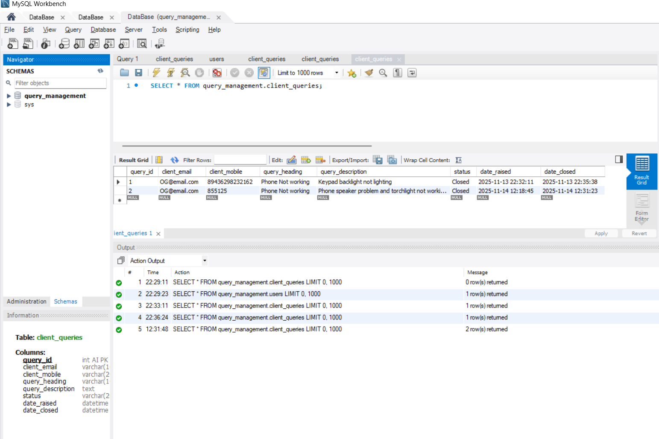
My SQL
Database named query_management is created on MY SQL workbench then later the Tables creation and data insertion was done through python by python my sql connector lib

Slide 4
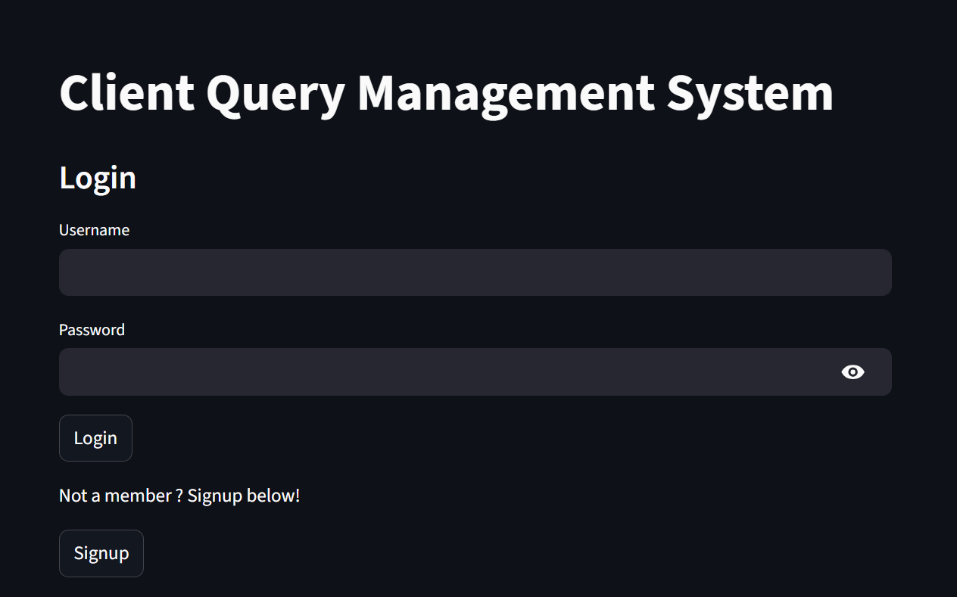
Login Page
The Login page has Username and Password along with login button
With the Username & Password the Login page recognises the role of the user and takes to the Query insertion dashboard if it’s a Client or to the support dashboard if it’s a Support person
There is a Signup Button for non members who can signup with the system and submit their product queries

Slide 5
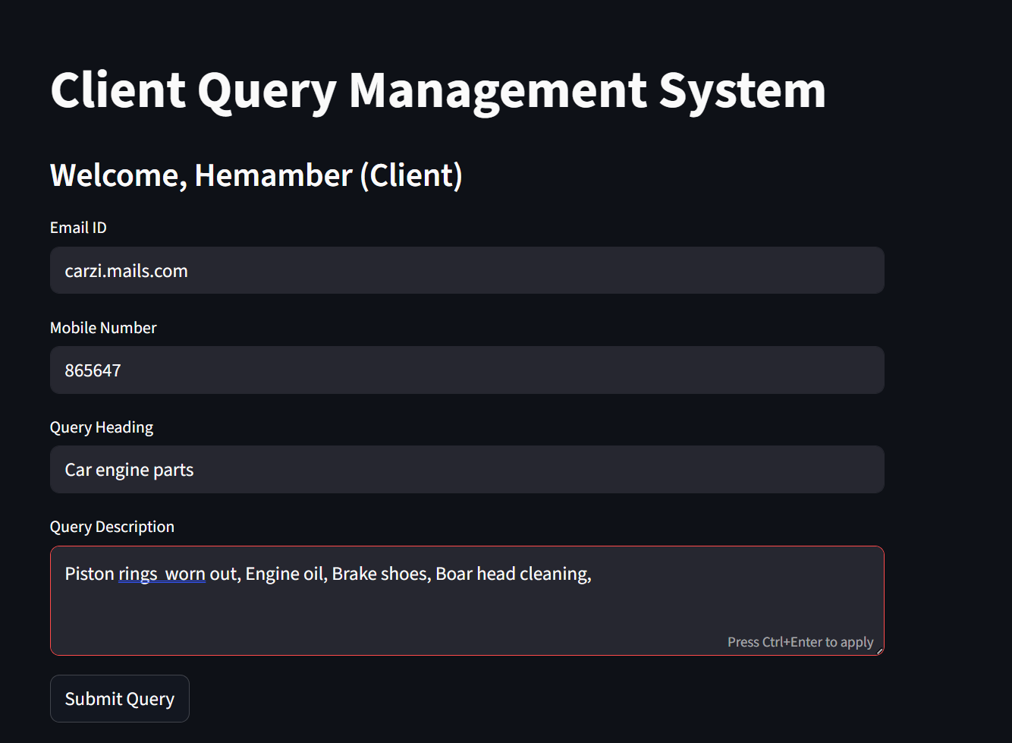
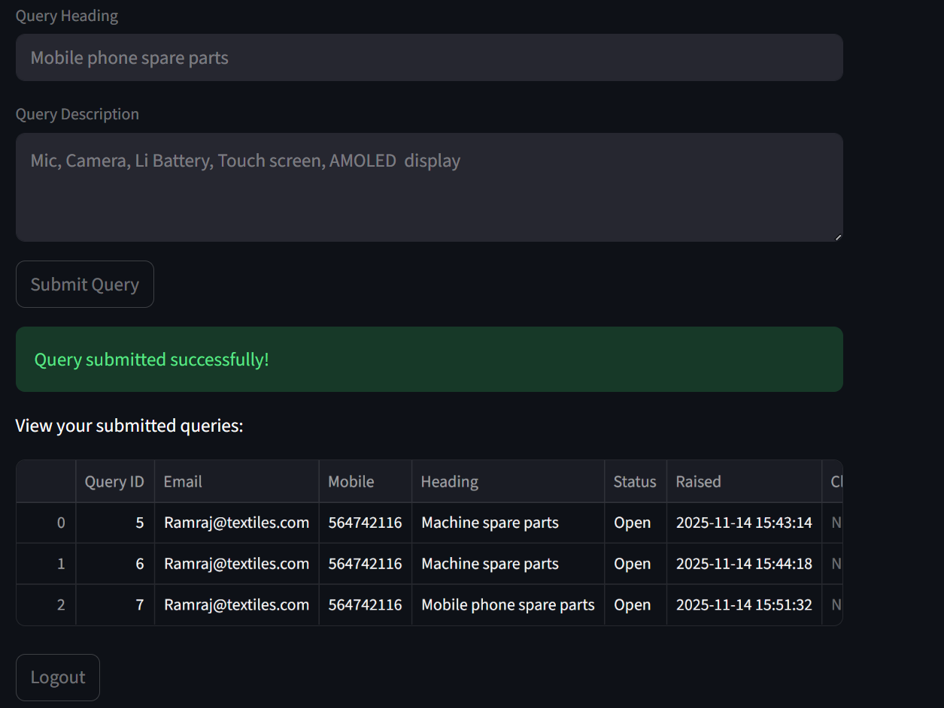
Client Query submission Form
The Query submitted data will be displayed as a table for the client after the query submission this helps the client to double check with the data that they given and with the logout button they can logout
The Query submission form will accept the query from the Client

Slide 6
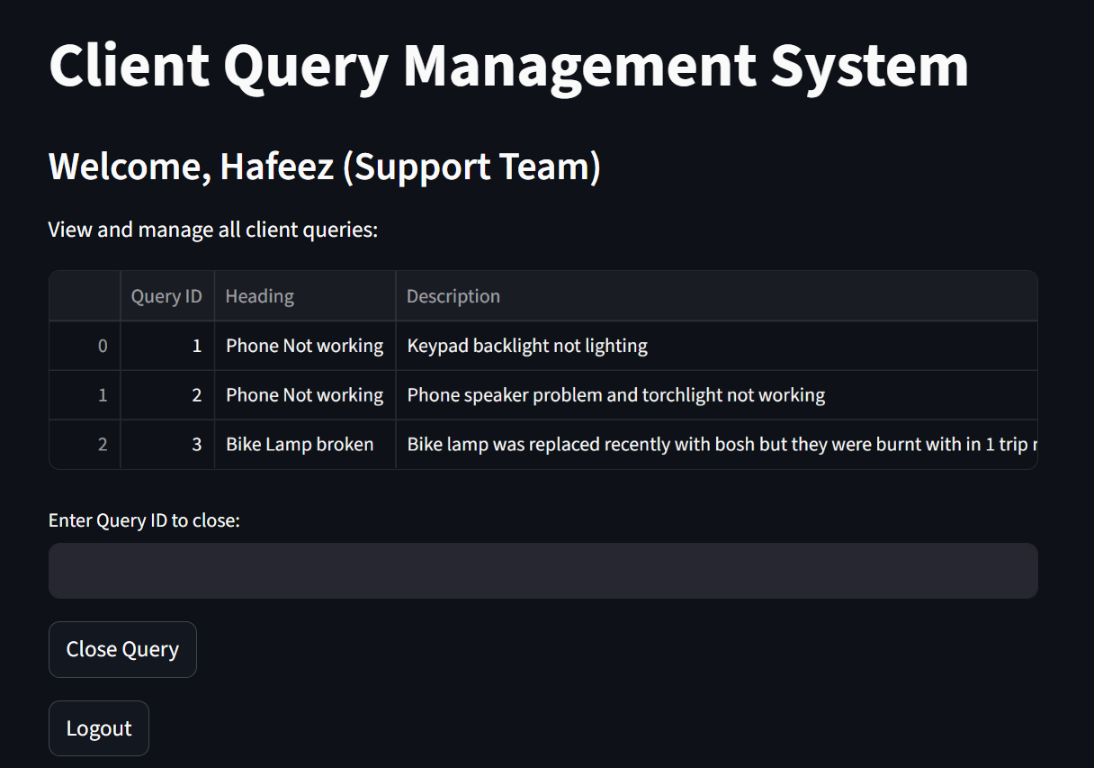
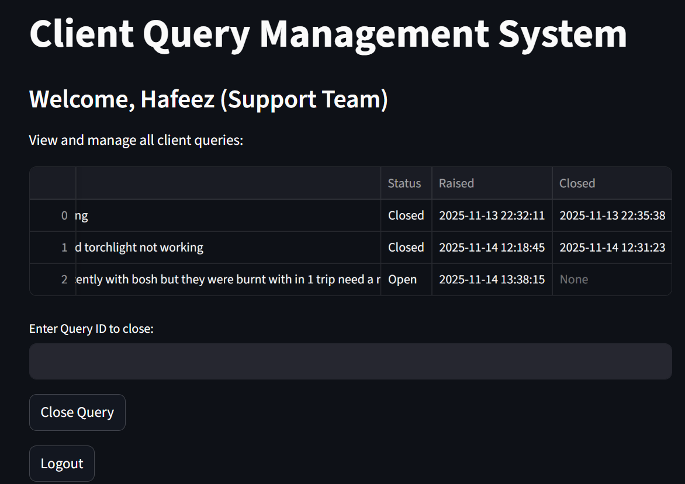
Support Team DashBoard
In the Support Dashboard we have only Query ID, Heading, Description, Status, Raised, closed and a box for query closing response along with the close query button to close the query when its done this information will be fed to the DataBase on MySQL
In the below image we can see how the support team can view the dashboard along the name of the support person

Slide 7
Conclusion:
The Client query management system helps as a mediation between Client & Support team for better data management & tracking.
It is a friendly & Interactive application for clients to raise their queries to reach out for a professional assistance on any product category.
The Support side dashboard is an interactive & user friendly where it is easily accessible.
The support team can submit the solutions to the clients query within the interactive dashboard

